Slide 1
Connective and Soft Tissue Neoplasm
A benign, intermediate, or malignant neoplasm that affects the connective and soft tissue
NCIT:C3810

Slide 2
Table of Contents
Introduction
Aim
Plots
Conclusion

Slide 3
Introduction
Different types (angiosarcoma, malignant peripheral nerve sheath tumor (MPNST), …)

Slide 4
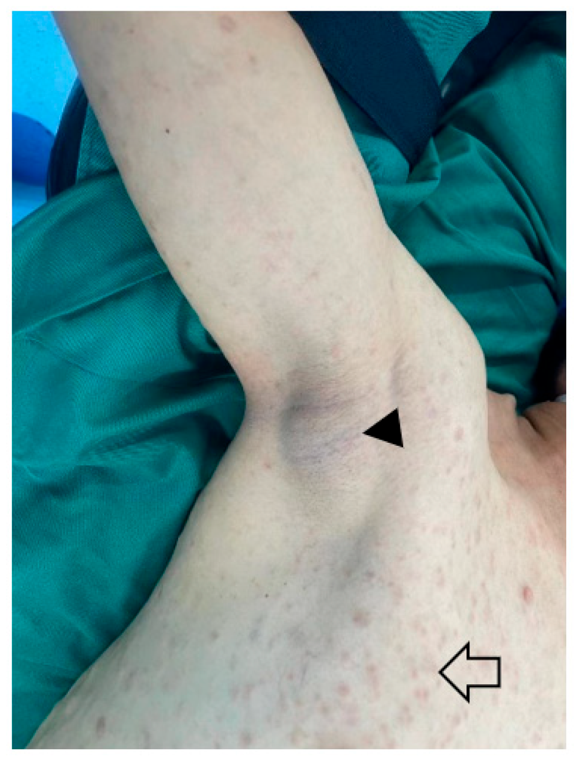
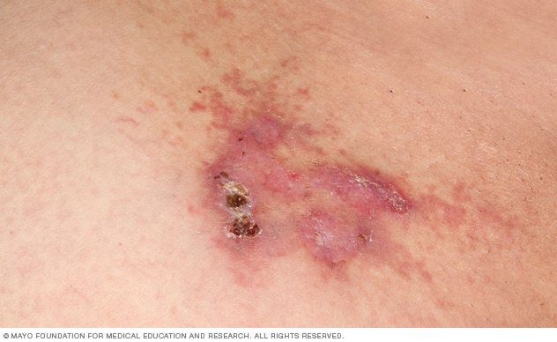
Introduction
Different types (angiosarcoma, malignant peripheral nerve sheath tumor (MPNST), …)
https://www.mayoclinic.org/diseases-conditions/angiosarcoma/symptoms-causes/syc-20350244
https://www.mdpi.com/2072-6694/15/4/1077

Slide 5
Introduction
Different types (angiosarcoma, malignant peripheral nerve sheath tumor (MPNST), …)
40% of sarcomas in patients aged 60+

Slide 6
Introduction
Different types (angiosarcoma, malignant peripheral nerve sheath tumor (MPNST), …)
40% of sarcomas in patients aged 60+
Causes are still investigated by researchers

Slide 7
Introduction
Different types (angiosarcoma, malignant peripheral nerve sheath tumor (MPNST), …)
40% of sarcomas in patients aged 60+
Causes are still investigated by researchers
Risk factors
Inherited: Li Fraumeni syndrome, Neurofibromatosis Type 1
Other: Radiation therapy, Lymphedema

Slide 8
Aim
Identifying and analyzing…
the survival probabilities of the different subtypes of connective and soft tissue neoplasms
the underlying genetic and non-genetic factors of the neoplasms
the distribution of connective and soft tissue neoplasms recordings in progenetix across different countries

Slide 9
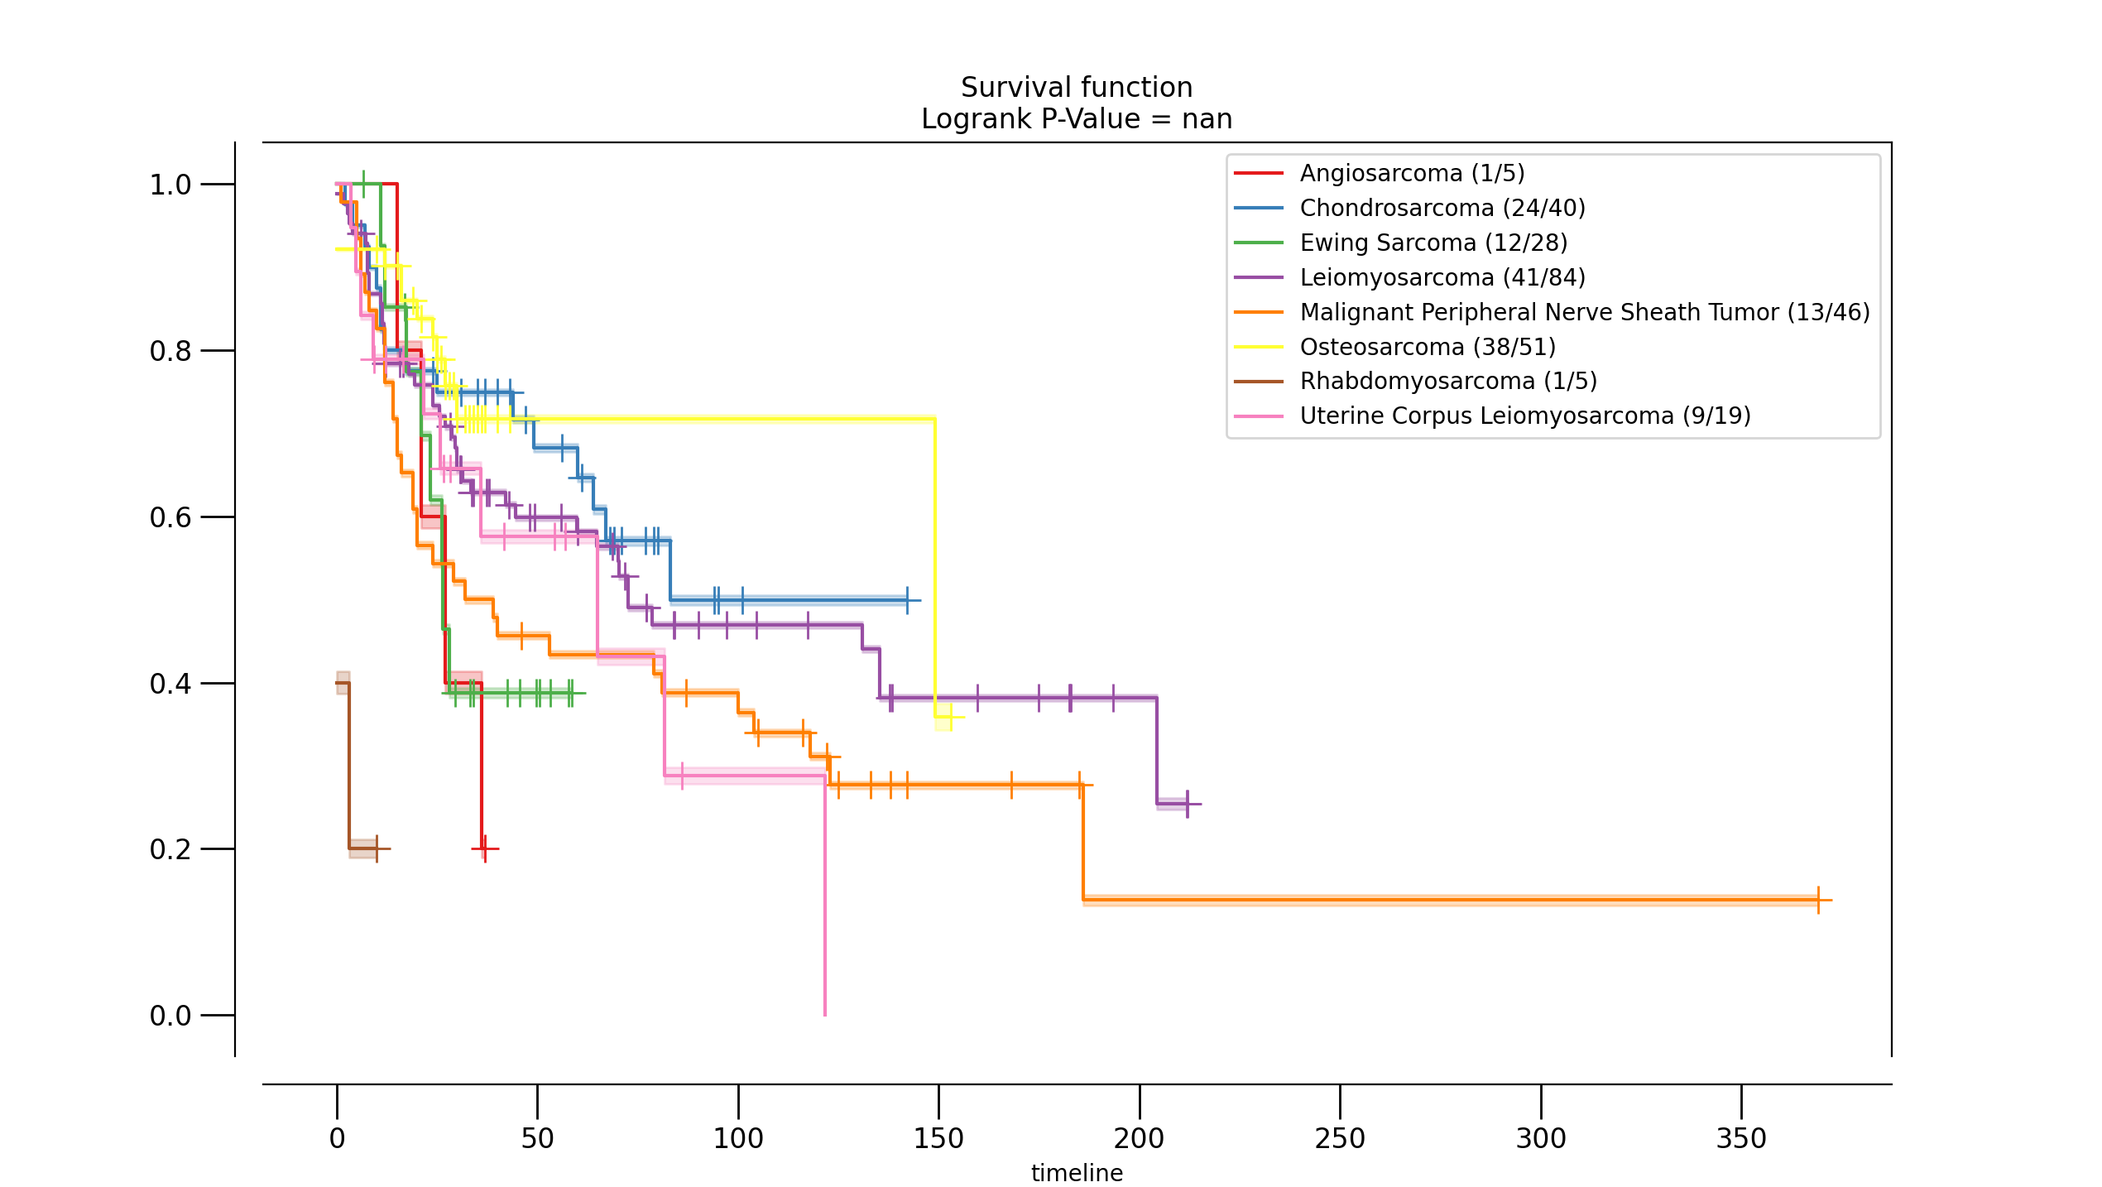
Plots
Survival probability
Time (months)

Slide 10
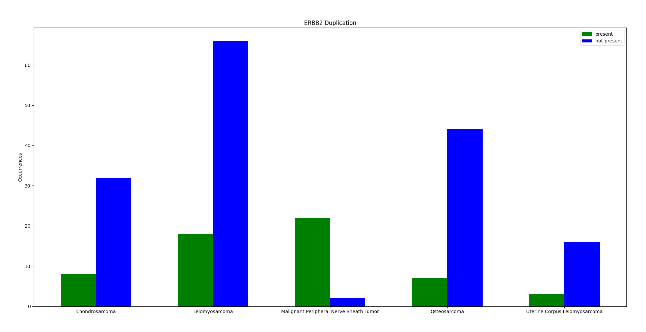
Plots

Slide 11
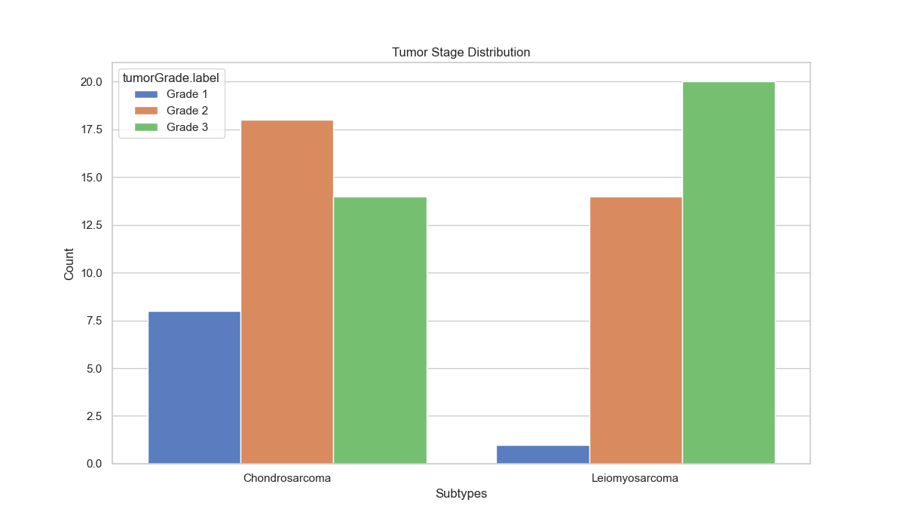
Plots

Slide 12
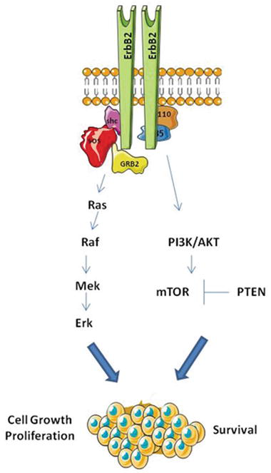
ERBB2 – erb-b2 receptor tyrosine kinase 2
oncogene
encodes a member of the epidermal growth factor (EGF) receptor family of receptor tyrosine kinases
enhances kinase-mediated activation of downstream signaling pathways
has been reported in numerous cancers
https://www.intechopen.com/chapters/53690

Slide 13
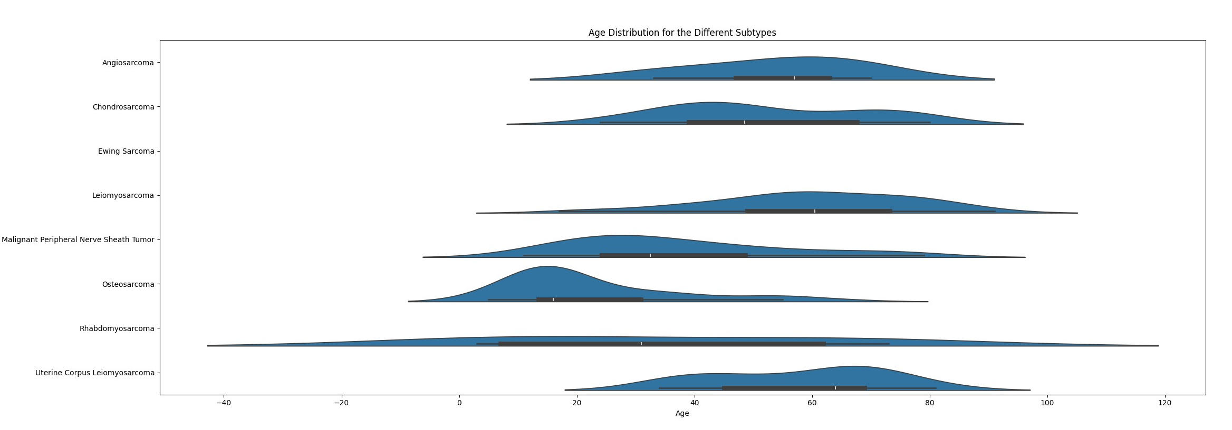
Plots

Slide 14
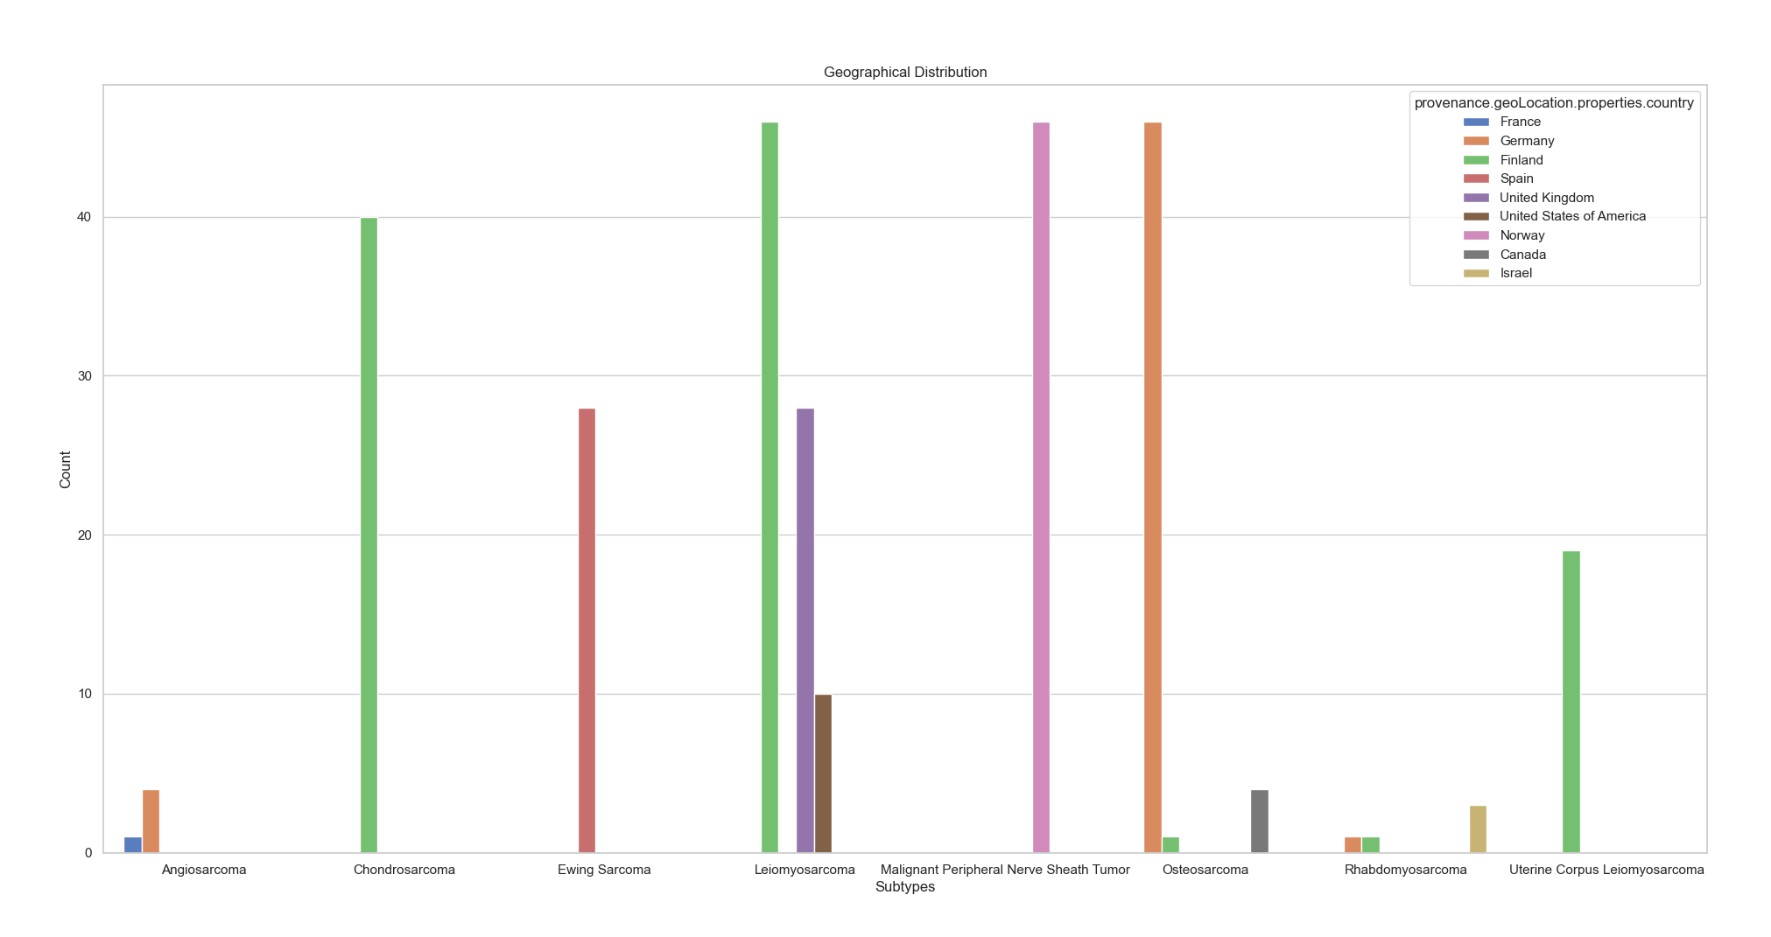
Plots

Slide 15
Conclusion
Best prognosis: Osteosarcoma, Chondrosarcoma
Worst prognosis: Uterine Corpus Leiomyosarcoma
ERBB2 as main gene mutated in connective and soft tissue sarcomas
Affects all age groups

Slide 16
List of References
https://www.mayoclinic.org/diseases-conditions/sarcoma/symptoms-causes/syc-20351048#:~:text=Sarcoma%20is%20a%20type%20of,tissues%20(soft%20tissue%20sarcoma) (last: 23-10-5)
https://www.cancercenter.com/cancer-types/soft-tissue-sarcoma/types#:~:text=There%20are%2050%20different%20types,and%20location%20of%20the%20tumor (last: 23-10-5)
https://www.cancer.gov/pediatric-adult-rare-tumor/rare-tumors/rare-soft-tissue-tumors/mpnst#:~:text=Malignant%20Peripheral%20Nerve%20Sheath%20Tumor%2C%20or%20MPNST%2C%20is%20a%20cancer,is%20a%20type%20of%20sarcoma (last: 23-10-5)
https://www.ncbi.nlm.nih.gov/gene/2064 (last: 23-10-5)
https://www.intechopen.com/chapters/53690 (last: 23-10-5)

Slide 17
Thank you

